Slide 1
DNS and the Web
CS 168 – Fall 2017 – Section 10
Notes:
Slides by Ankit Mathur

Slide 2
Agenda
The Domain Name System (DNS)
The Web (HTTP)

Slide 3
DNS

Slide 4
DNS
Map a name to an IP
Goals
Replacement for HOSTS.TXT
Fully distributed maintenance
Tolerable performance

Slide 5
DNS
eecs.berkeley.edu
edu
berkeley
eecs
Domains delegate to subdomains
“edu” delegates control of “berkeley” to UC berkeley
“berkeley” delegates control of “eecs” to the EECS department
…

Slide 6
DNS Records
NS
Delegate control of a subdomain
A
IP address
AAAA
IPv6 Address
MX
Mail server
Many more!

Slide 7
Iterative DNS Lookup
Where is www.wikipedia.org?
Go ask .org server at 1.2.3.4
DNS server
Where is www.wikipedia.org?
.org servers
Go ask wikipedia.org server at 5.6.7.8
Where is www.wikipedia.org?
Where is www.wikipedia.org?
Answer record: 9.10.11.12
wikipedia.org servers
DNS client (me.cs.berkeley.edu)
Notes:
DNS client requests www.google.com

Slide 8
Caching DNS Replies
DNS responses cached in DNS servers
Expire after TTL
Most popular sites visited often
Top sites perpetually cached… fast!
DNS server
(mydns.berkeley.edu)
Hostname | IP
www.google.com | Z
www.google.com
IP: Z
DNS client (me.cs.berkeley.edu)

Slide 9
Web

Slide 10
Anatomy of a URL
protocol://hostname[:port]/directorypath/resource
protocol | http, ftp, https, smtp, rtsp, etc.
hostname | DNS name, IP address
port | Defaults to protocol’s standard port e.g. http: 80 https: 443
directory path | Hierarchical, reflecting file system
resource | Identifies the desired resource Can also extend to program executions: http://us.f413.mail.yahoo.com/ym/ShowLetter?box=%40B%40Bulk&MsgId=2604_1744106_29699_1123_1261_0_28917_3552_1289957100&Search=&Nhead=f&YY=31454&order=down&sort=date&pos=0&view=a&head=b

Slide 11
HTTP
Client-server architecture
Server is “always on” and “well known”
Clients initiate contact to server
Synchronous request/reply protocol
“Synchronous” means same HTTP session used for request and reply
Runs over TCP, Port 80
Stateless
No information about previous requests kept in HTTP

Slide 12
Requests and Responses
Request
Response
GET /somedir/page.html HTTP/1.1
Host: www.someschool.edu
User-agent: Mozilla/4.0
Connection: close
Accept-language: fr
(blank line)
HTTP/1.1 200 OK
Connection close
Date: Thu, 06 Aug 2006 12:00:15 GMT
Server: Apache/1.3.0 (Unix)
Last-Modified: Mon, 22 Jun 2006 ...
Content-Length: 6821
Content-Type: text/html
(blank line)
data data data data data ...
Notes:
Request:
Request line: method, resource, and protocol version
Request headers: provide information or modify request
Body: optional data (e.g., to “POST” data to the server)
Reponse:
Status line: protocol version, status code, status phrase
Response headers: provide information
Body: optional data

Slide 13
Performance!
Wise man once said “Architect for flexibility, engineer for performance”
We have an architected solution – let’s explore ways to make it go fast

Slide 14
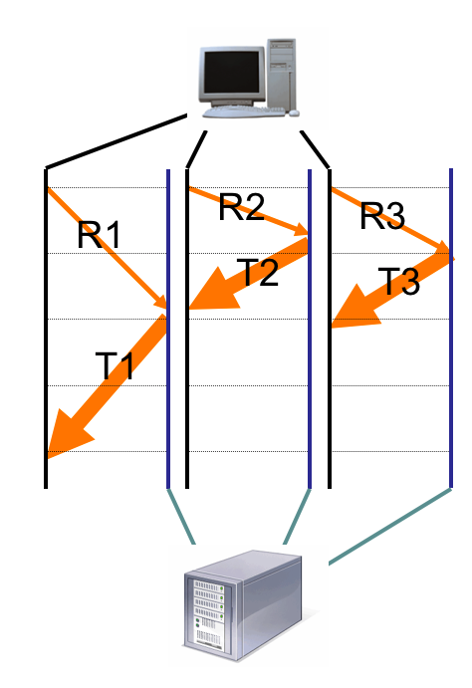
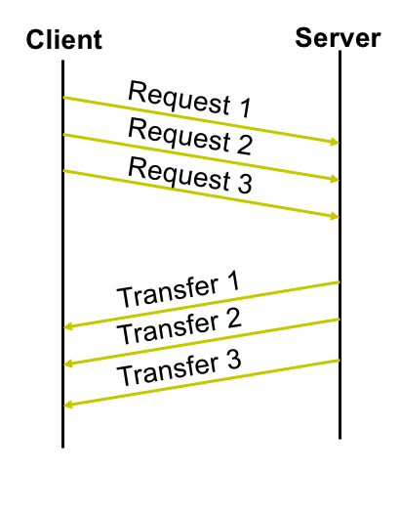
Request Patterns
Concurrent
Pipelined
Persistent
SYN
SYN + ACK
ACK + R1
T1
ACK + R2
T2
ACK + R3
T3
Notes:
Concurrent:
Great, but makes the network sad ☹
Persistent:
Performance advantages:
Avoid overhead of connection set-up and tear-down
Allow TCP to learn more accurate RTT estimate
Allow TCP congestion window to increase
i.e., leverage previously discovered bandwidth
Pipelined:
Batch requests and responses to reduce the number of packets. Multiple requests can be contained in one TCP segment

Slide 15
Caching: How
Idea: Replication
Replicate the content across multiple copies to reduce bottlenecks
Implementation: content distribution networks (CDNs)
The client content provider modifies its content so that embedded URLs reference the new domains.
“Akamaize” content
e.g.: http://www.wikipedia.org/cats.jpg becomes http://a128.g.akamai.net/cats.jpg

Slide 16
Caching: Specifics in HTTP
Modifier to GET requests:
If-modified-since – returns “not modified” if resource not modified since specified time
Response header:
Expires – TTL: how long it’s safe to cache the resource
No-cache – ignore all caches; always get resource directly from server
When making request, if within the TTL, just load cached resource.
Otherwise, send with if-modified.
Server will either send a HTTP 304 (not changed) or HTTP 200 (changed, and here’s the new data)

Slide 17
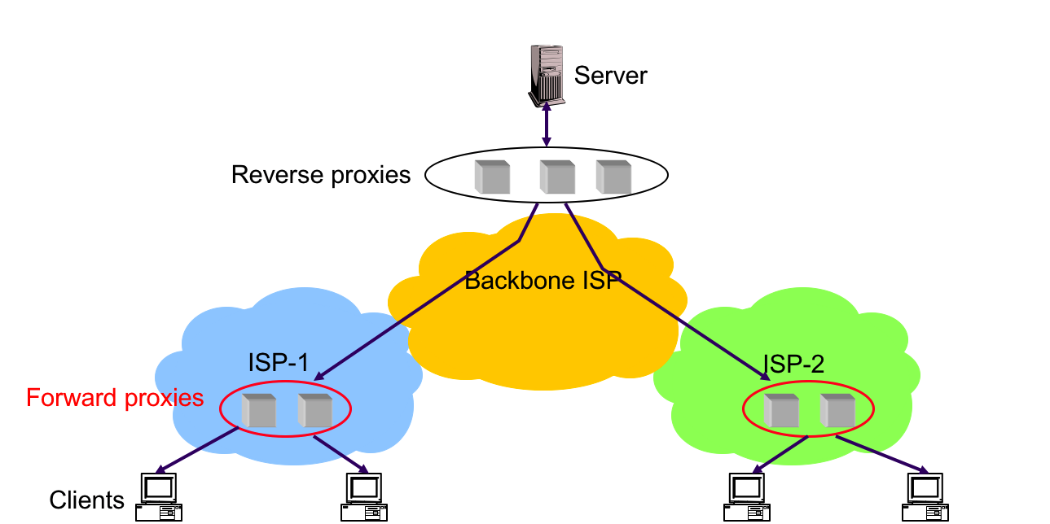
Caching: Where
Forward Proxies
Cache near the client
Reverse proxies
Reduce server load

